Slide 1
Farely
Brought to you by Chill
Chulpaibul Jiraporn
Leong Ko Rixie Tiffany
Nguyen Duy Khanh
Rachel Khan
Tran Anh Tai
Truong Quang Duc

Slide 2
Overview
Project Overview
Features / Functionality (Use Case)
Software Engineering Practices
System Design
Object Design
Traceability
One Use Case: Calculate Fare
Live Demo
Q&A
F A R E L Y

Slide 3
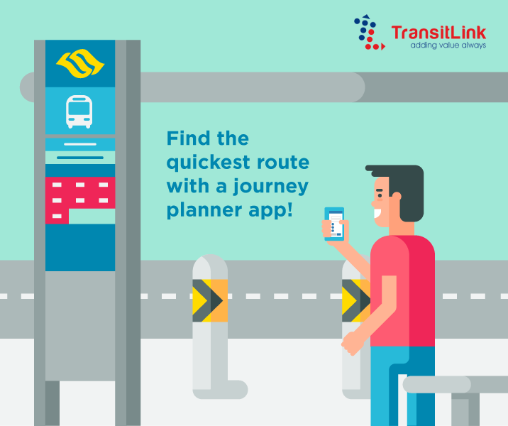
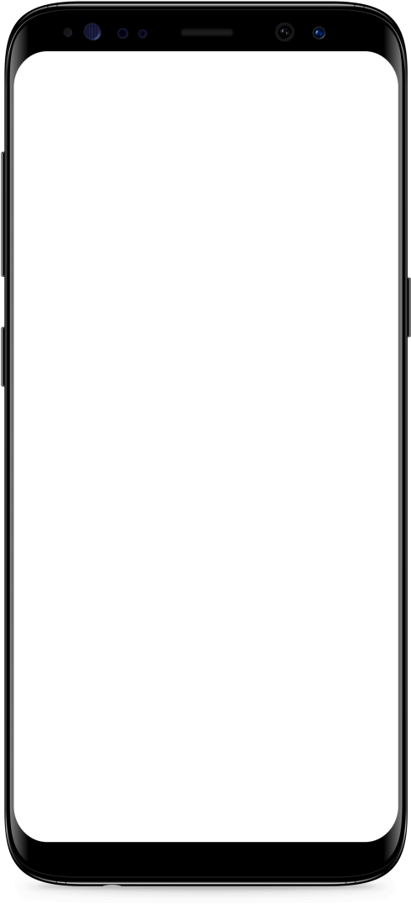

Journey with
Farely
Notes:
http://www.studentshow.com/zgallery/28510263/TransitLink

Slide 4
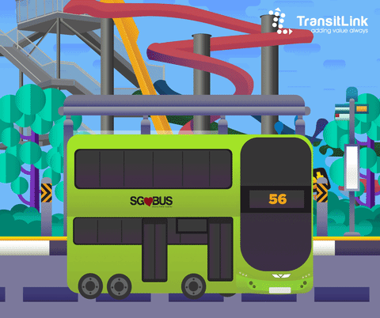
Project Overview
What is Farely ?
Public transport Android application

Slide 5


Objective
Help commuters to find the best routes for their journeys
Minimize commuters’ public transportation costs

Slide 6
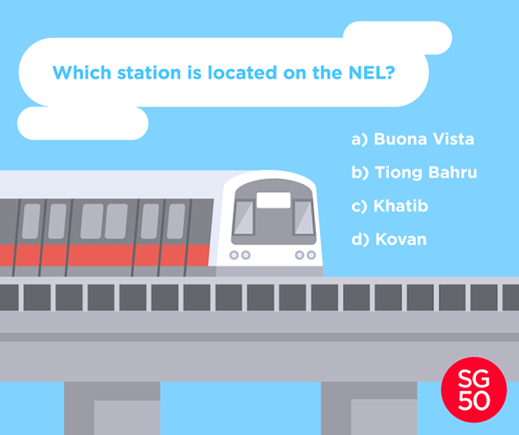
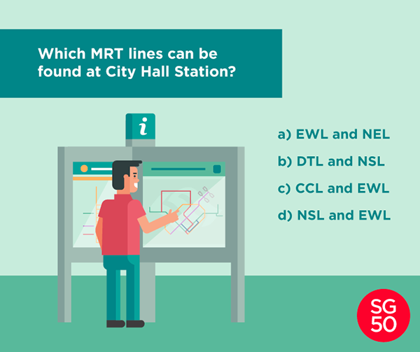
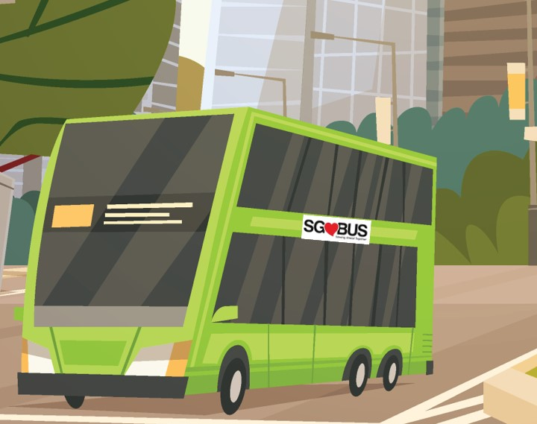
Features / Functionalities
3 main features:
Accept user route queries
Display sorted routes
(based on price, distance or time)
Display route details

Slide 7

Features / Functionalities
Additional feature :
Display location’s air quality and
weather

Slide 8
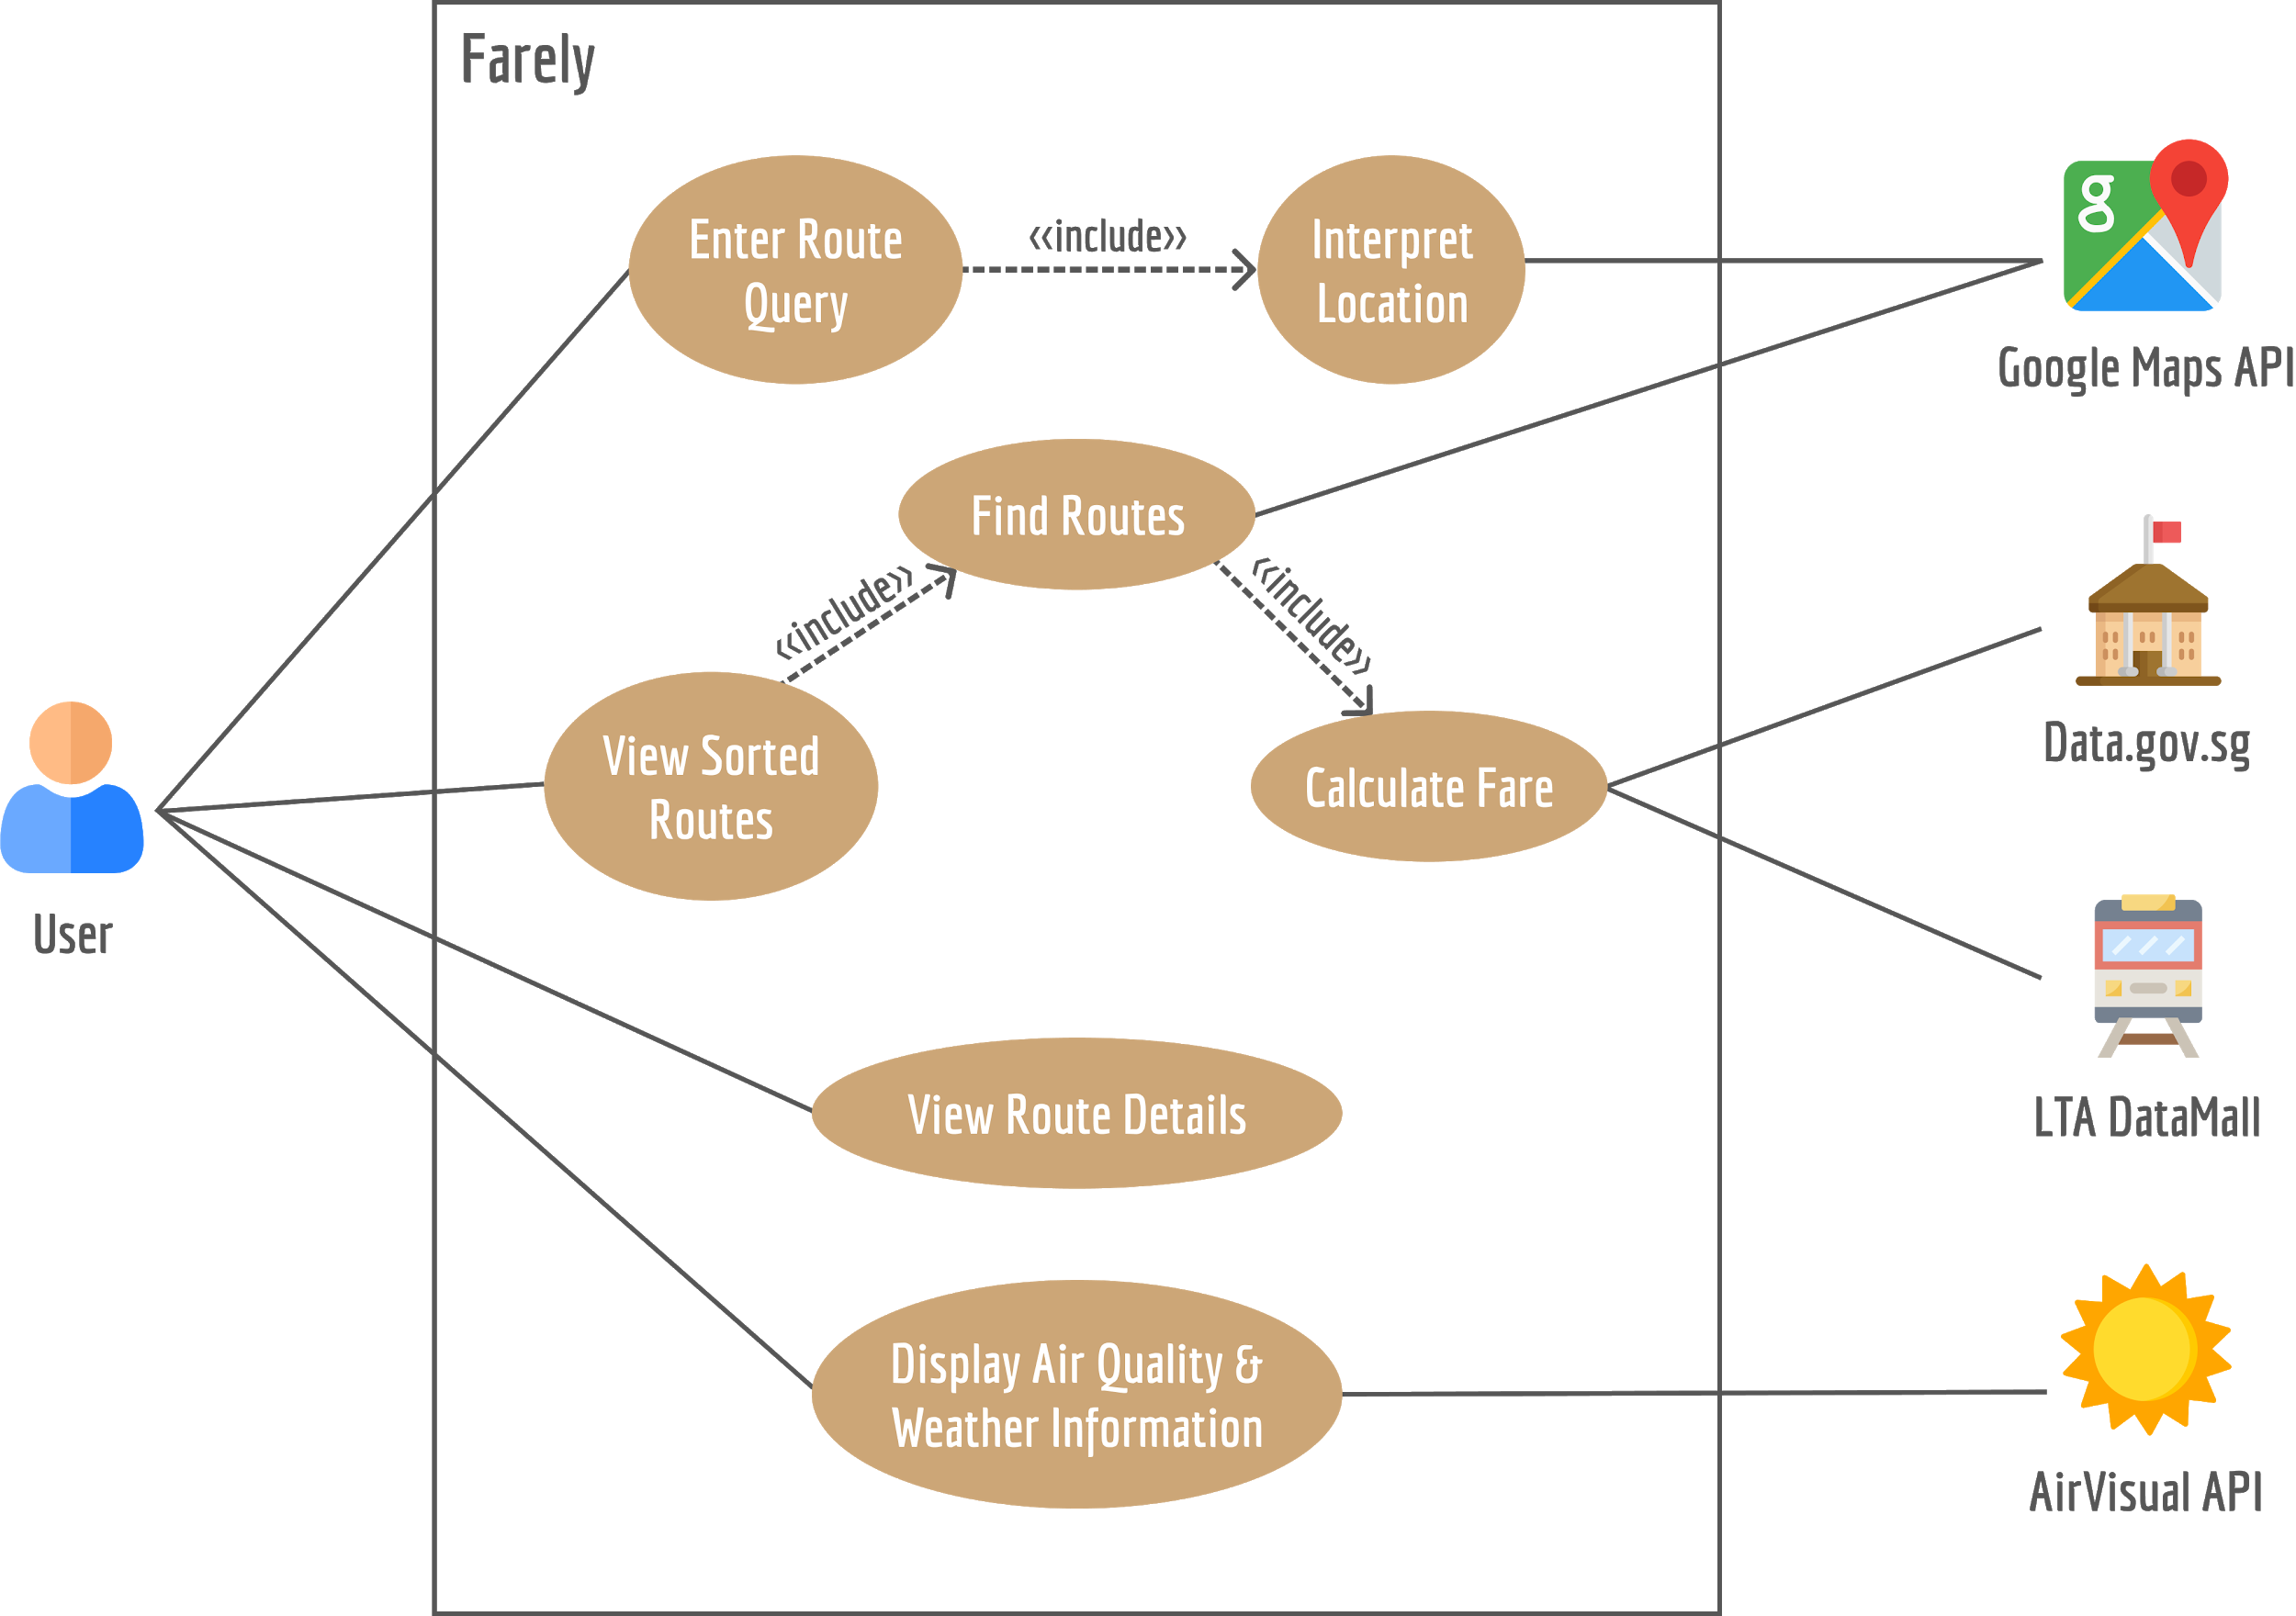
Use Case Diagram
Notes:
User: https://www.flaticon.com/free-icon/user_1077012?term=person&page=1&position=32
Google Maps: https://www.flaticon.com/free-icon/google-maps_888856?term=GOOGLE%20maps&page=1&position=18
Data.gov.sg: https://www.flaticon.com/free-icon/government-buildings_675240?term=government&page=1&position=11
LTA DataMall: https://www.flaticon.com/free-icon/train_2729904?term=train&page=1&position=1
AirVisual API: https://www.flaticon.com/free-icon/sunny_979585?term=weather&page=1&position=14

Slide 9

Software Engineering Practices
Notes:
Image: https://undraw.co/

Slide 10

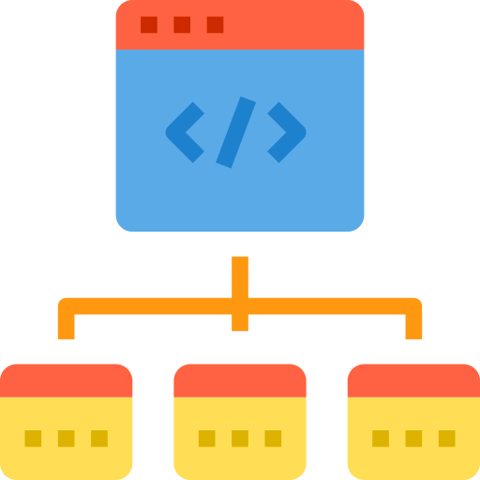


Software Development Lifecycle
Requirements Elicitation
Requirements Analysis
Implementation
System & Object Design
Notes:
To develop this project, we followed the software development lifecycle.
During the requirements elicitation phase, we created our functional and nonfunctional requirements.
During the requirements analysis phase, we created our analysis models, such as our use case model and dialog map, based on the requirements.
During the system & object design phase, we developed our system architecture and used design patterns for our object design.
After that, we started implementing our code based on the previous phases.
Requirements Elicitation: https://www.flaticon.com/free-icon/meeting_755192?term=interview&page=1&position=4
Requirements Analysis: https://www.flaticon.com/free-icon/website_1641037
System & Object Design: https://www.flaticon.com/free-icon/sketch_681560?term=design&page=1&position=24
Implementation: https://www.flaticon.com/free-icon/html_1826760?term=code&page=1&position=78

Slide 11
System Design

Slide 12


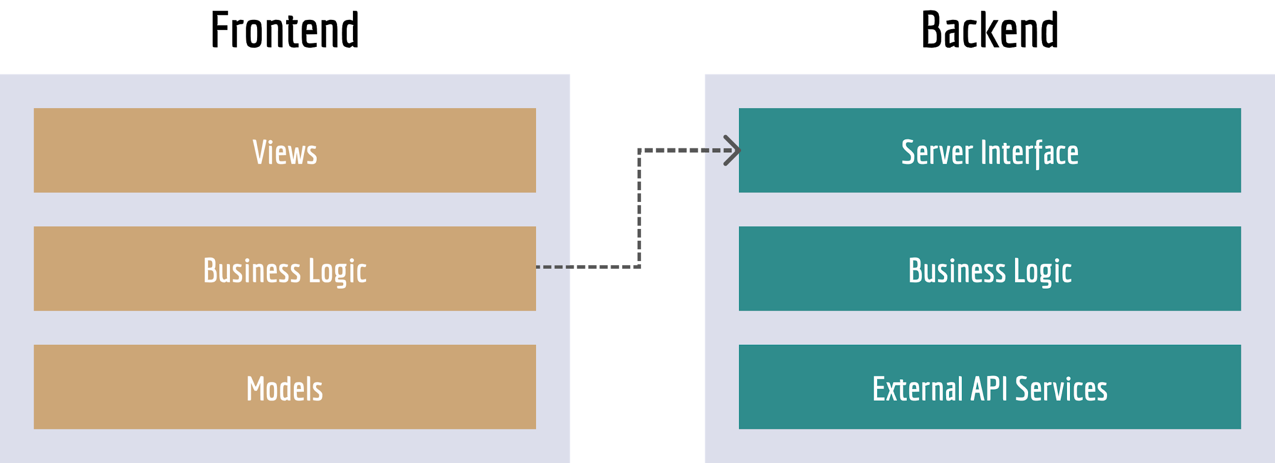
Client & Server + Layered System
Notes:
Frontend: https://www.flaticon.com/free-icon/android_888839?term=android&page=1&position=1
Backend: https://www.flaticon.com/free-icon/server_758345?term=server&page=1&position=47

Slide 13
Object Design

Slide 14

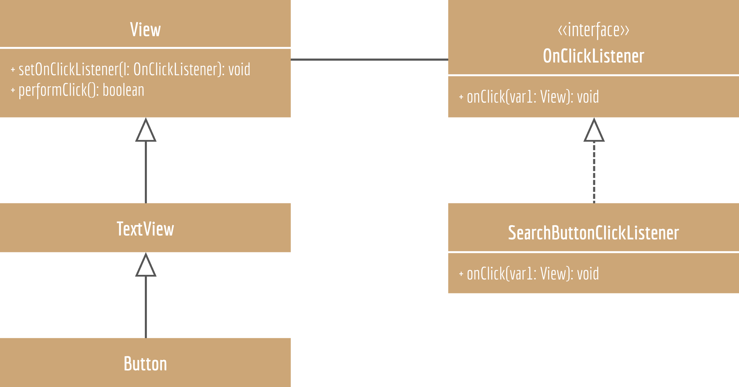

Observer Pattern
Notes:
Observer Pattern
Problem: Have many objects (observers) to receive an update when another object (subject) changes
Pros: Abstracts coupling between subject & observer, supports broadcast communication, enables reusability of subjects & observers independently of each other
Button: https://www.flaticon.com/free-icon/search_202479?term=search%20button&page=1&position=9
Listen: https://www.flaticon.com/free-icon/ear_1005531?term=listen&page=1&position=3

Slide 15
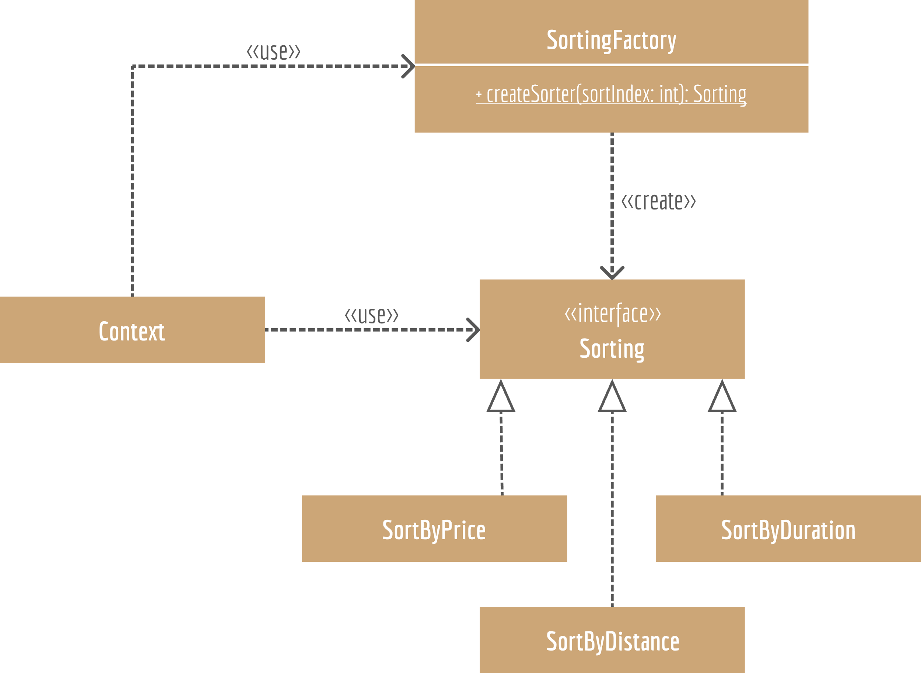


Factory Pattern + Strategy Pattern
Notes:
Strategy pattern
Problem: Algorithms/objects should be interchangeable
Pros: Provides encapsulation, hides implementation, allows behaviour change at runtime, allows you to create a new strategy by adding a subclass
Factory Pattern
Problem: Have a set of classes, but don’t know which you’ll need until runtime, don’t want to expose the client to creation logic
Pros: Encapsulate object creation (remove duplicate object creation code), easy to extend, replace or add new subclasses, easy to change object creation logic
Strategy: https://www.flaticon.com/free-icon/strategy_2728193?term=strategy&page=1&position=2
Factory: https://www.flaticon.com/free-icon/powerplant_2728420?term=factory&page=1&position=85

Slide 16


Traceability
Docs: Google Drive
Code: GitHub
Notes:
What is Traceability?
Google Drive: https://www.flaticon.com/free-icon/drive_281771?term=google%20drive&page=1&position=28
GitHub: https://www.flaticon.com/free-icon/github_2111422?term=GITHUB&page=1&position=24

Slide 17
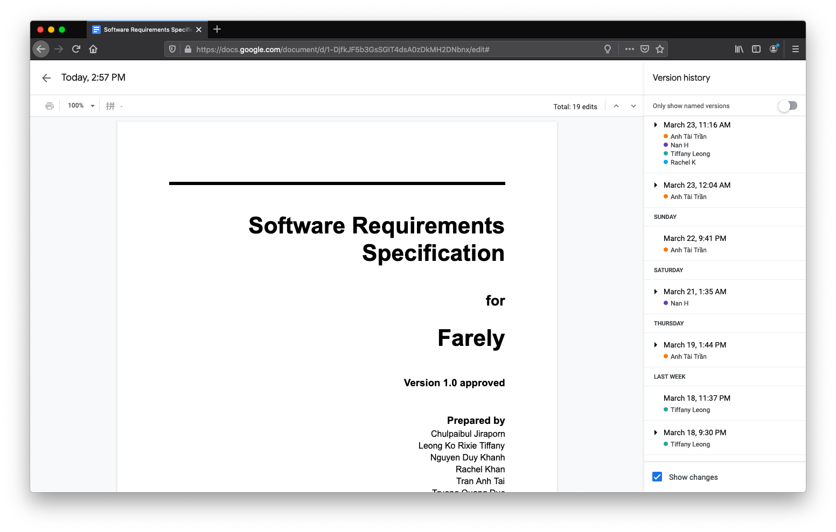
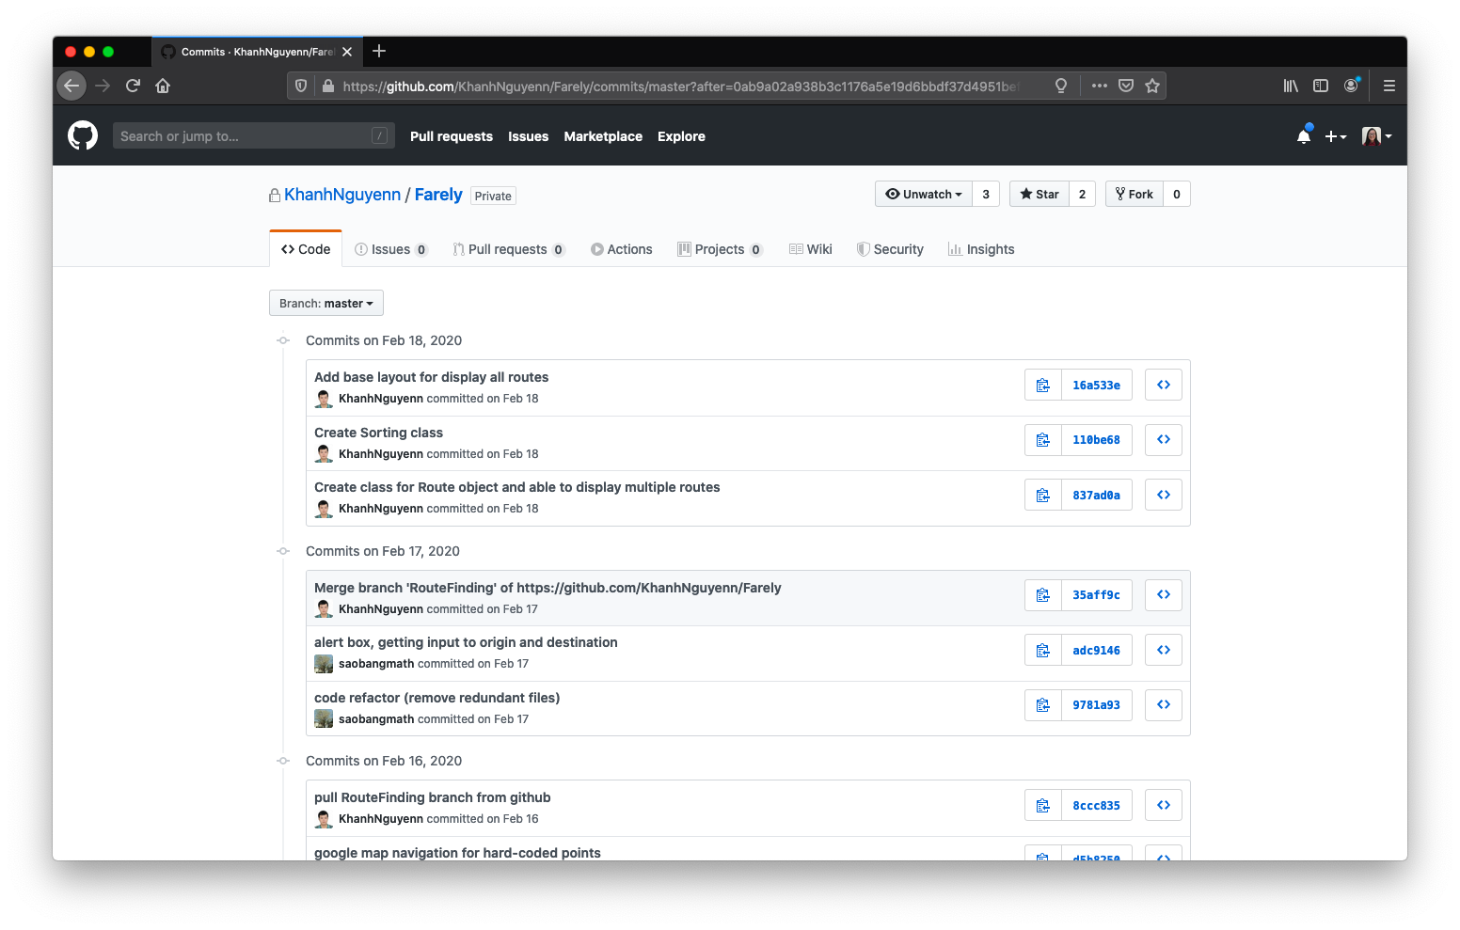
Traceability
Docs: Google Drive
Code: GitHub

Slide 18
Use Case: Calculate Fare

Slide 19
Use Case Description
The system fetches bus, MRT and LRT fare data from data.gov.sg API
The system fetches the bus service information from the Land Transport Authority’s DataMall API
The system calculates the total price using the data queried from Land Transport Authority’s DataMall and Data.gov.sg API

Slide 20
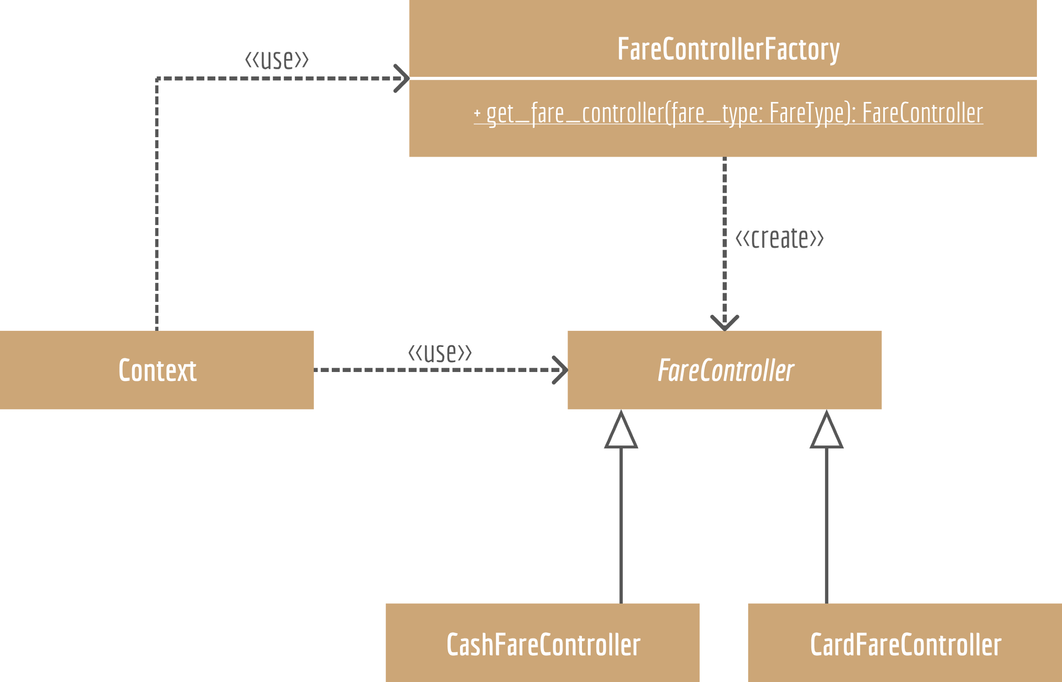
Class Diagram
Notes:
Strategy pattern + factory pattern
Strategy: https://www.flaticon.com/free-icon/strategy_2728193?term=strategy&page=1&position=2
Factory: https://www.flaticon.com/free-icon/powerplant_2728420?term=factory&page=1&position=85

Slide 21
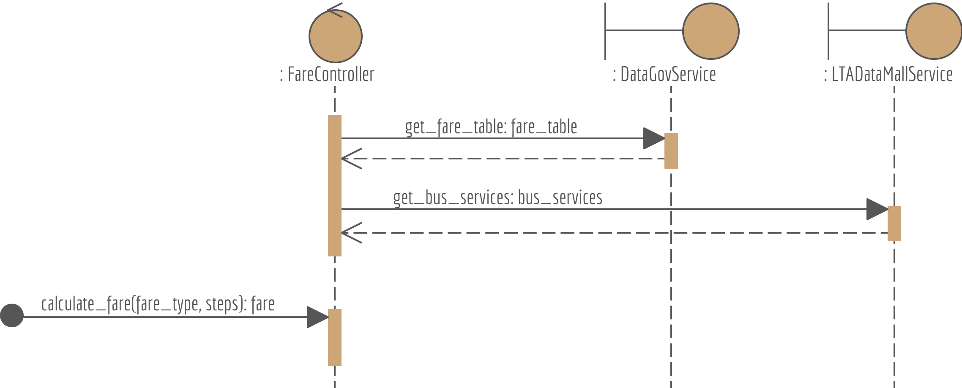
Sequence Diagram

Slide 22
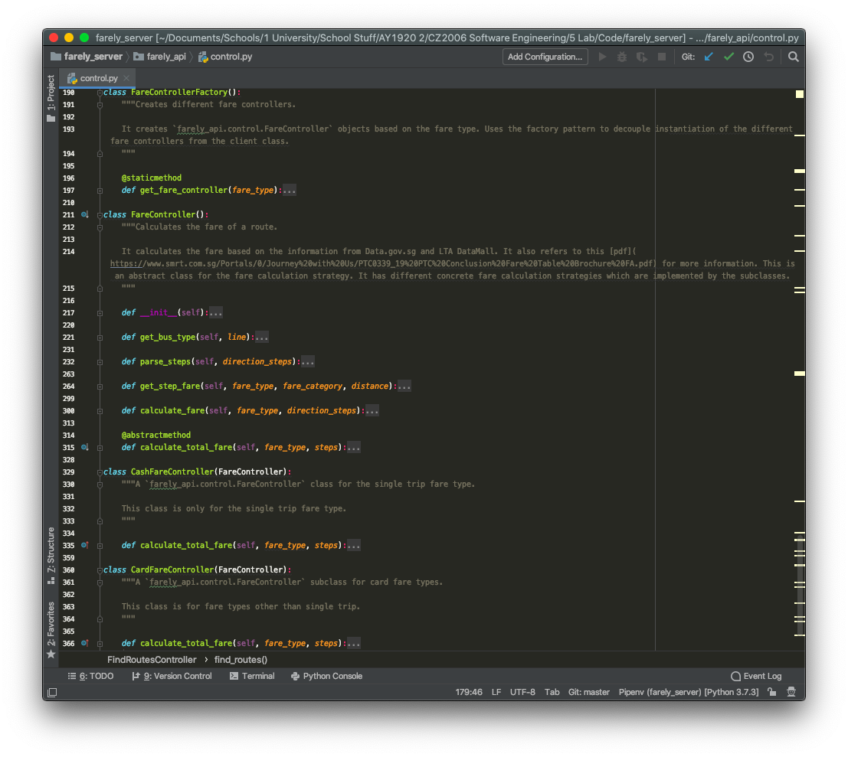
Implementation

Slide 23
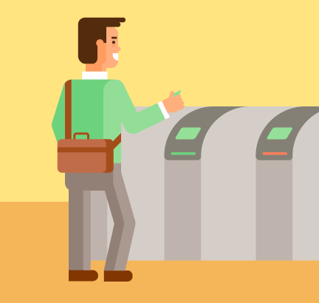
Demo

Slide 24
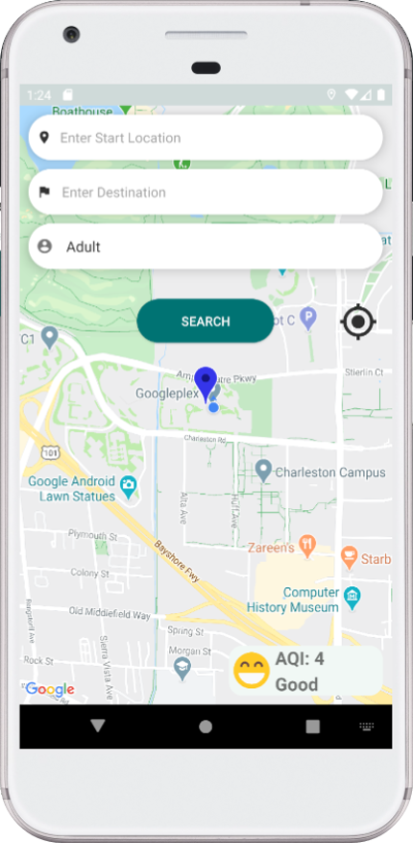
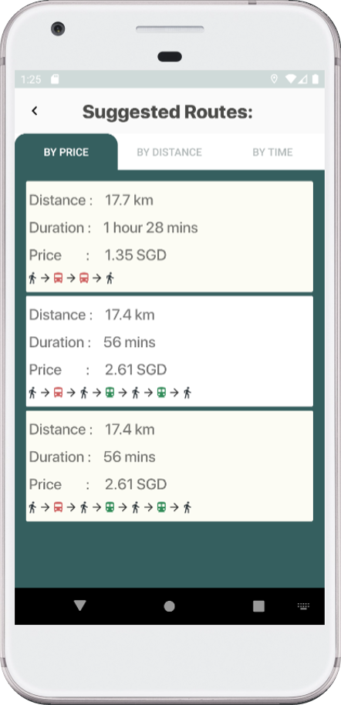
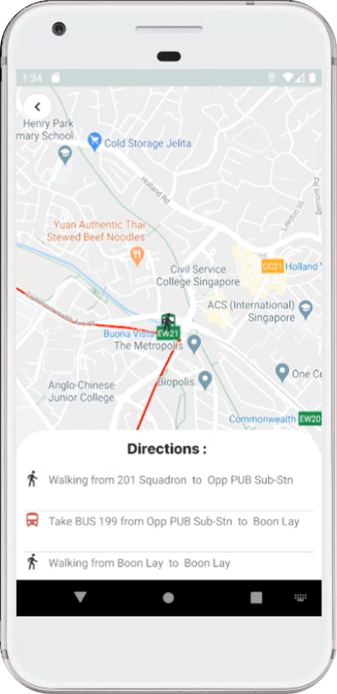
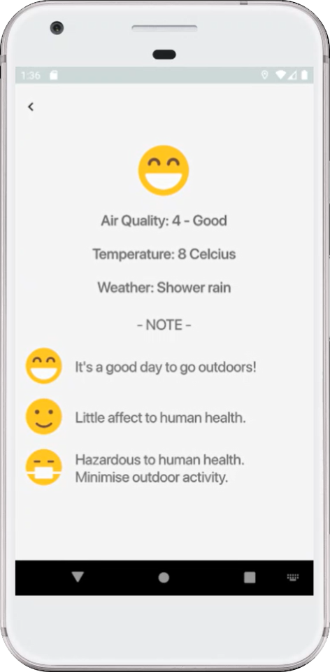

Slide 25

Backend
External API Services
Google Maps API
Directions API
Places API
LTA DataMall
Data.gov.sg
Fares for Express Bus Services
Fares for Feeder Bus Services
Fares for Trunk Bus Services
Fares for MRT and LRT Services
Notes:
We use google map direction api to find possible routes from origin to destination. The direction api will return a response to us in json format andd we will extrac a list of routes

Slide 26
Backend API
Backend Documentation

Slide 27
Work Breakdown
Documentation: Duc
Design: Rachel
Frontend: Tai & Khanh
Backend: Jiraporn & Tiffany

Slide 28
Thank You

Slide 29
Questions & Answers

